Slide 1
OS Module in Python
DVT101 – Lecture 48
- By Dataverse Tutorials

Slide 2
Introduction to OS Module in Python
What is the OS module
Why Python needs OS interaction
OS module as a bridge between Python and system
Real-world motivation

Slide 3
Why OS Module is Important
Interaction with files and folders
Automating system-level tasks
Platform-independent operations
Usage in real applications and scripts

Slide 4
Understanding Operating System Context
What is an Operating System
How programs interact with OS
Role of environment and file system
OS dependency vs Python portability

Slide 5
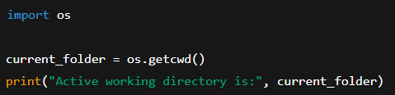
Current Working Directory (CWD) Concept
Meaning of current working directory
Difference between script location and CWD
Why CWD matters in file operations
Common beginner confusion

Slide 6
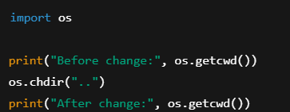
Getting and Changing CWD
Concept of fetching current directory
Concept of changing working directory
Impact on file access
Practical use cases

Slide 7
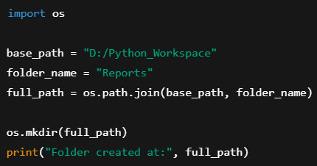
Directory Creation Basics
Why directories are created programmatically
Single-level directory creation concept
Permission and existence checks
When directory creation fails

Slide 8
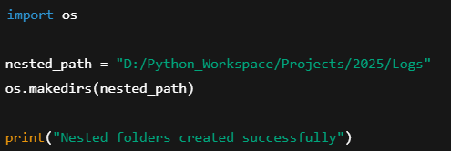
Recursive Directory Creation
Need for nested directories
Difference between single and recursive creation
Automatic parent directory handling
Real project folder structures

Slide 9
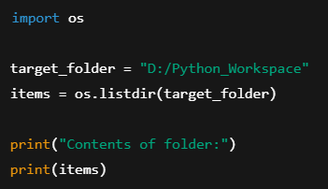
Listing Files and Directories
Why listing directory content is needed
File discovery concept
Directory traversal basics
Automation and monitoring use cases

Slide 10
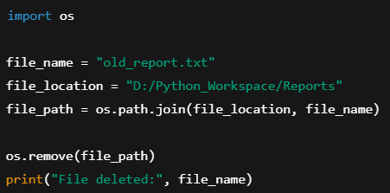
Deleting Files Safely
File deletion concept
Difference between file and directory deletion
Risk of accidental data loss
Safety considerations

Slide 11
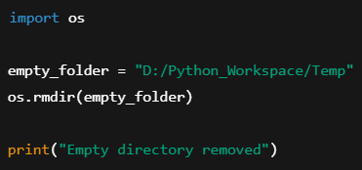
Deleting Directories
Empty directory deletion concept
Why non-empty directories fail
Cleanup operations
Use cases in automation

Slide 12
File Permissions and Ownership
What permissions mean
Read, write, execute basics
Owner, group, others concept
Security implications

Slide 13
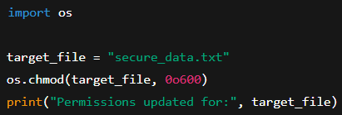
Changing File Permissions
Why permissions are modified
Permission modes overview
Security and access control
System administration use cases

Slide 14
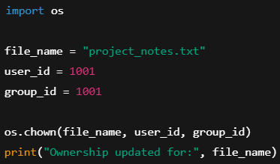
File Ownership Management
Ownership concept in OS
User ID and group ID idea
Platform dependency
Administrative scripts

Slide 15
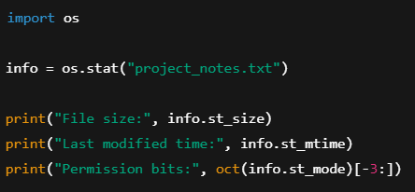
File Metadata and Statistics
What metadata is
File size, timestamps, modes
Why metadata is useful
Auditing and monitoring

Slide 16
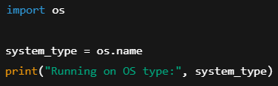
OS Identification
Detecting operating system
Cross-platform scripting
Conditional logic based on OS
Deployment scenarios

Slide 17
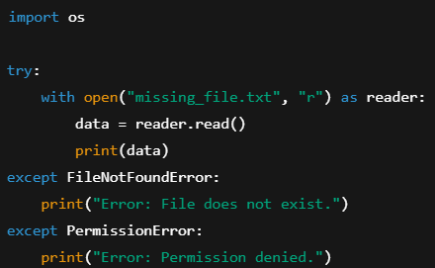
Error Handling in OS Operations
Why OS operations fail
Types of system errors
Graceful failure handling
Robust scripting mindset

Slide 18
Legacy and Low-level OS Functions
Command execution concept
Difference between high-level and low-level APIs
File descriptor basics
Why some methods are discouraged

Slide 19
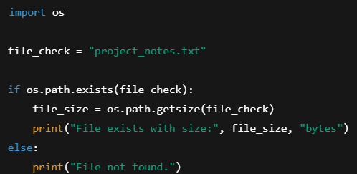
File Existence and Size Checking
Why existence check is important
Preventing runtime failures
File size usage
Pre-validation in scripts

Slide 20
Real-World Industry Use Cases
Automation scripts
DevOps and system maintenance
Data engineering pipelines
Backend and deployment tasks

Slide 21
Summary & Key Takeaways
What OS module enables
Core capabilities recap
When to use OS module
Transition to advanced system scripting

Slide 22


